Slide 1
Practical lesson № 2 Infectious safety Nosocomial infections Prevention of nosocomial infections

Slide 2
«Infection»
«Infection» is a biological phenomenon characterized by the interaction of a pathogenic microorganism with a macroorganism (human).
«Infectious process»
«Infectious process» - a complex of adaptive reactions of the organism in response to the introduction and proliferation of the pathogen. (Reactions aimed at restoration of homeostasis and disturbed biological equilibrium with the environment).
Microorganism that can cause infectious disease is called a pathogen.
Properties of pathogen:
Invasiveness - the ability of the pathogen to penetrate through the skin and mucous membranes into the internal environment of a macroorganism.
Toxigenicity — the ability of microbes to produce toxins.

Slide 3
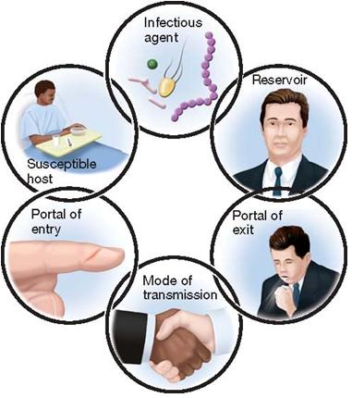
List the Components of the chain of infection.
Main Components of the chain of infection (simple version).
Infectious agent (pathogen)
Route of transmission
Susceptible host.

Slide 4
Nosocomial infections
Nosocomial infection (hospital) - is any clinical microbial disease, affecting the patient as a result of hospitalization or hospital visits in order to receive treatment.
Nosocomial infection is a disease developed in a patient 48 hours after admission, and health care worker involved in the treatment and care of patients in the hospital.
NAME THE TWO FORMS OF NOSOCOMIAL INFECTION (classification):
Endogenous infection (self-infection, or auto infection).
2. Exogenous infection (Cross-contamination followed by cross-infection):

Slide 5
1. Endogenous infection (self-infection, or auto infection).
The causative agent of the infection is present in the patient at the time of admission to hospital but there are no signs of infection. The infection develops during the stay in hospital as a result of the patient’s altered resistance
hematogenic way - infection spreads with blood flow.
lymphogenic way - infection spreads with lymph flow.
Endogenic sources of infection are carious teeth, pathological center of chronic infection of internal organs - gallbladder inflammation (cholecystitis), bronchi inflammation (bronchitis) and so on.

Slide 6
2. Exogenous infection (Cross-contamination followed by cross-infection):
During the stay in hospital the patient comes into contact with new infective agents, becomes contaminated, and subsequently develops an infection.
Name the Sources of hospital infection
1) patients with acute or chronic form of infectious diseases.
2) infection carriers (carriers do not get sick, but they can pass the infection to others);
3) medical staff.

Slide 7
List the Route of transmission:
Fecal-oral route
Arogenic (respiratory)
Vector-borne (blood) route
Contact route

Slide 8
Transmission:
Transfer factors:
The localization of the pathogen:
1. Fecal-oral route
Rout of transmission
The transmission mechanism | Transmission | Transfer factors | The localization of the pathogen
Fecal-oral route (food) | Alimentary (food); Water; Contact-household | Food Water Dishes, utensils, dirty hands, etc. | The digestive tract

Slide 9
Aerogenic (respiratory) route
Transmission:
Transfer factors:
The localization of the pathogen:
The transmission mechanism | Transmission | Transfer factors | The localization of the pathogen
Arogenic (respiratory) | Airborne; Air-dust | The air Dust | Respiratory system
Coughs and sneezes spread diseases!

Slide 10
Vector-borne (blood) route
Transmission:
Transfer factors:
The localization of the pathogen:
The transmission mechanism | Transmission | Transfer factors | The localization of the pathogen
Vector-borne (blood) route | Bite of blood-sucking Parenteral | Blood-sucking arthropods Blood, blood products Syringes, surgical tool | Blood system

Slide 11
Contact route
Transmission:
Transfer factors:
The localization of the pathogen:
 | Transmission | Transfer factors | The localization of the pathogen
Contact route | Wound Contact-sexual | Soil The secret glands, the presence of blood components | Skin and mucous membranes

Slide 12
The prevention of nosocomial infection (Two basic principles )
1. Early detection of source of infection
Identification of infectious patients on admission
Isolation of infectious patients
Preventive medical examination of medical personnel
2. Cut off any route of transmission of infection
Clinical hygiene of medical staff
Collection and disposal/decontamination of waste
Cleaning of premises
Disinfection
Sterilization

Slide 13
REMEMBER!
Health care workers are responsible for providing a safe environment for patient.
It is easy to forget key procedural steps or to take shortcuts that break aseptic procedures when hurried.
Failure to follow proper techniques place patients at risk for an infection that can seriously impair their recovery and may even lead to death.

Slide 14
MEDICAL WASTE, classification
CLASS "A". Not dangerous waste.
CLASS «Б». Dangerous waste.
CLASS «B». Extraordinarily dangerous waste.
CLASS «Г». Toxicologically dangerous waste.
CLASS «Д». Radioactive waste

Slide 15
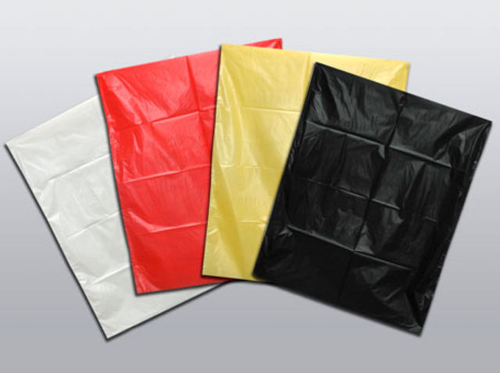
MEDICAL WASTE
CLASS "A". Not dangerous waste
It is non-toxic waste, not having contact with body fluids of patients, infectious patients.
Not dangerous CLASS "A" is formed:
1. In the wards in all structural units of hospital.
2. In administrative quarters
3. In the buffet, in the nutrition unit.
4. In the territory of hospital
!!! Territory infectious, dermatovenerologic, tuberculous hospitals is exception.
Not dangerous CLASS «A» is collected in a disposable package (packages, cans) white colour.

Slide 16
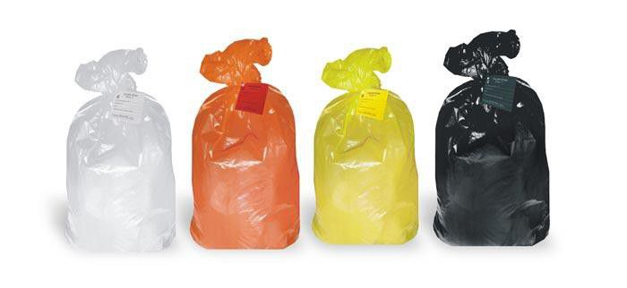
CLASS «Б". Dangerous waste. Dangerous waste is potentially infected waste, contaminated by secretions and blood of patients.
Places of formation:
Waste from any inpatient Department contaminated biological fluids
Treatment rooms,
Dressings rooms,
Manipulation rooms
Operating rooms
Pathoanatomical department
Diagnostic Department (laboratory)
Food waste from infectious disease department
Dangerous waste CLASS «Б» is collected in a disposable hermetic package (packages, cans) yellow colour.
Marking - Dangerous waste. Class «B», code of department, name of the hospital, date, name of the responsible for collection of waste.

Slide 17
CLASS «В». Extraordinarily dangerous waste
CLASS «В» is waste contacted with sick of especially dangerous infections.
Places of formation waste CLASS «В»:
Departments for patients with especially dangerous and quarantine infections:
Tuberculosis hospital and departments
Infectious and dermatovenerologic departments
Mycological hospitals
Materials from patients with anaerobic infection.
Waste CLASS «В» is collected in a disposable hermetic package red colour (packages and hard packing).
Marking - "Extraordinarily dangerous waste. Class C,code of department, name of the hospital, date, name of the responsible for collection of waste.
CLASS “Г” - Toxicologically dangerous waste
Waste CLASS «Г» is
Expired medicines
Toxic drugs (cytostatic drug and other chemicals, mercury-containing objects,
Used disinfectants,
Medical apparatus and equipment.
Waste CLASS «Г» is collected in a disposable hermetic package (packages, cans) black colour.
Marking - Waste. Klass D, code of department, name of the hospital, date, name of the responsible for collection of waste.

Slide 18
CLASS «Д». Radioactive waste
Waste CLASS «Д» is all kinds of waste containing radioactive components.
Places of formation:
1. Diagnostic laboratories or departments
2. Radioisotope laboratory
3. X-ray rooms
Collection, storage and removal waste of this class carry out in accordance with the rules for work with radioactive substances.

Slide 19
Collection and disposal/decontamination of medical waste 2 ways: centralized way and decentralized way
Scheme centralized way
Scheme decentralized way
waste collection in place of formation
Waste collection in place of formation
Waste disinfection
Recycling of waste in a medical organization in a special equipment
Waste transportation from place of collection in the places temporary storage
Transportation of waste from hospital in specialized neutralizing organization
Recycling of waste in a special organizations

Slide 20
Give the definition «Disinfection»
Disinfection - is the destruction of pathogenic and conditionally pathogenic microorganisms in the air, on-site equipment and medical products in the treatment-and-prophylactic institution.

Slide 21
Disinfection
Preventive disinfection is aimed at preventing the occurrence of infections, in the absence of the focus of infection. It is provided in the treatment-prophylactic institution, is carried out by medical personnel (orderlies, junior medical personnel, nurses).
Focal disinfection (antiepidemic) is carried out in the case of appearance of infectious disease or at the suspicion on it.
1. Preventive planned disinfection is carried out in the hospital continuously; is carried out according to the plan maked accordingly with peculiarity of hospital departments.
1. Focal current disinfection – is conducted constantly in a treatment-prophylactic institution or at home surrounded by the patient (or Bacillicarrier) after detection in a patient of nosocomial infection and before discharge (or transfer to another Department/hospital).
2. Preventive disinfection on epidemic indications is carried out with the occurrence of nosocomial infection in one from hospital departments (or in one from chambers). For example, the patient is ill by the influenza in the one ward. Purpose - prevent the spread of infectious agents in other departments.
2. Focal final disinfection – is carried out once after, after discharge or death, the hospitalization the patient in an infectious hospital.
3. Preventive disinfection on sanitary and hydenic indications is carried out once at the contamination.

Slide 22
List the Methods of disinfection:
Mechanical method
2. Chemical method
3. Physical method
4. Combined method
5. Biological method

Slide 23
STERILIZATION Methods of sterilization:
Sterilization - is the complete destruction of microorganisms and their spores by exposure to physical factors and chemicals matters.
All products are subjected to sterilization in contact with a wound surface, blood, certain types of medical instruments.
Methods of sterilization:
Physical method - steam , air , gasperlenovy , radiation .
Chemical method - the disinfectant solution, gas, plasmative .In clinical practice most commonly used thermal ( physical) method of sterilization:

Slide 24
Scheme of processing of medical equipment
medical equipment (object)
Medical objects of nursing for patients
Medical instruments
Reusable medical equipment (heater, thermometer, etc.)
Disposable medical equipment (bandage material , syringes and other)
Disinfection
Pre-sterilization processing
Disinfection
Disinfection
Utilization
control of sterilization processing
Sterilization

Slide 25
The main stages of processing MEDICAL TOOLS:
1 stage. disinfection
2 stage. pre-sterilization processing
3 stage. control of sterilization processing
4 stage. sterilization

Slide 26
CLINICAL HYGIENE OF MEDICAL STAFF
Keep your body clean.
Wear special clothes: a medical bathrobe, a medical cap, shoes.
Use protectors: gloves, mask, goggles.
Wash your hands

Slide 27
Keep your body clean: Take shower every day.
Do not use cosmetics with a strong and sharp smell
Medical gown (bathrobe)
Special clothes of a modern medical worker – a medical gown.
There are many microbes on clothes. Caps, bathrobe, trousers and shoes are most contaminated with microbes.
On medical bathrobe the hospital microbes can be found in a few hours of wearing, especially on the sleeves, on the area of abdomen and on the hips.
It is necessary to have a special room where a doctor can change clothes.
Work clothing and personal clothing must be kept separately.
Doctors must wear a bathrobe over their own clothes and it must fully cover personal clothes of a doctor.
Sleeves must be short in order to make hand wash easier.

Slide 28
Medical cap
Hair - is a huge area that can collect and then distribute microorganisms.
It is necessary to wear a cap in the surgical department. The hair must be hide under the medical cap.
It is necessary to replace medical cap daily.
Shoes (footwear)
Footwear must be closed in order to protect feet against contact with blood and other biological fluids. Shoes must be made of nonwoven fabric, so that it can be exposed to cleaning and disinfection.

Slide 29
Protectors
Working in aseptic and infected areas medical staff should wear protective disposable masks. Mask should be replaced every 2 hours, and after each surgery.
All the dirty work must be done in oilcloth aprons. Apron is worn over the bathrobe.
In case of contact with the patient doctors must wear rubber disposable gloves.
Safety glasses (when working with blood).

Slide 30
HAND WASHING
Hands – are the most likely source of infection. It is necessary for every medical worker to care for them.
Skin microflora
Resident microflora (constant). It is impossible to destroy completely this microflora.
Transient microflora (temporary). It is received through any contact with the environment.

Slide 31
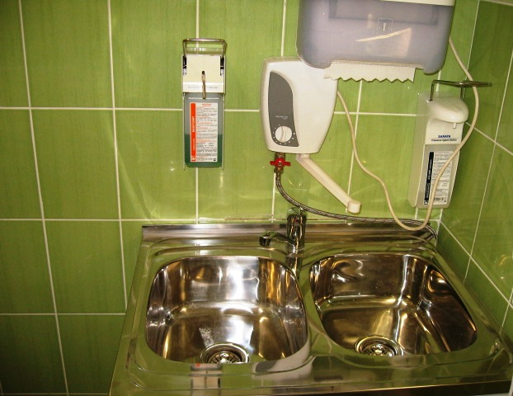
There are three stage of hand processing:
1 stage . Hygenic washing of hands
2 stage . Hygienic processing of the hands
3 stage . Scrubbing of hands (surgical stage)

Slide 32
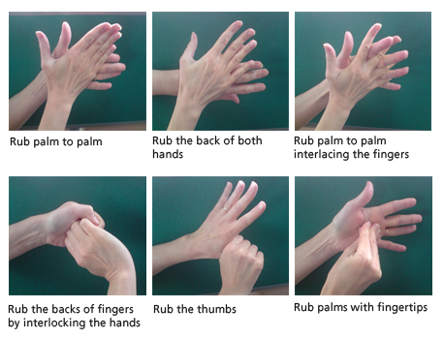
Steps of hand washing

Slide 33
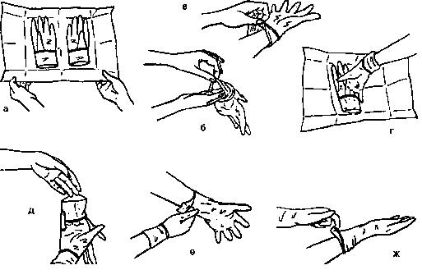
Technique putting on sterile gloves:

Slide 34
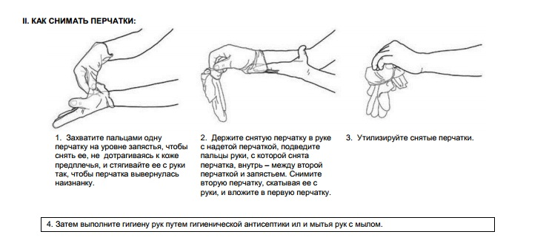
Technique putting off sterile gloves:

